Slide 1
CSE 322 NS3 Presentation
Topic name: Workflow of Traffic Control Layer In NS3
Topic no: 9
Student ID: 1705045, 1705054,1705058

Slide 2
Overview of workflow of aqm(active queue management)
Memory buffers implement Queues to hold packets
Absorb bursts of traffic
TCP cannot function correctly if buffers run full
Packets are dropped to avoid this
Active queue management: The proactive dropping of packets

Slide 3
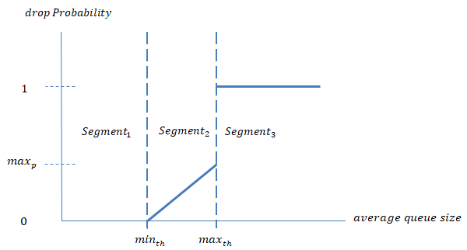
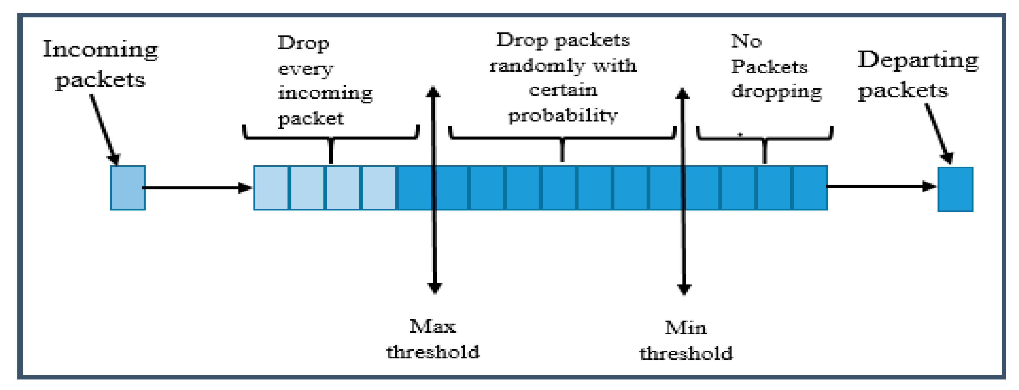
OVERVIEW OF WORKFLOW OF AQM

Slide 4
AQM IN NS3
Outgoing packets traverse two queueing layers
First queueing layer - traffic control layer
Notified by the NetDevice when the device queue is full
QueueDisk - abstract base class providing the interface and implementing common operations

Slide 5
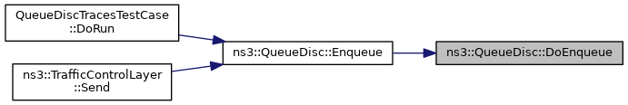
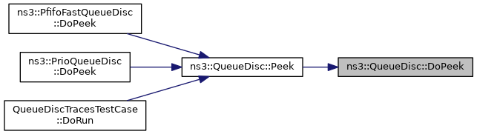
AQM in ns3
Abstract view of major functions of QueueDisc:
Enqueue: Enqueues a packet into the queue disc
Dequeue: Extracts from the queue disc
Peek: Get a copy of the next packet the queue will extract. Default implementation retains it into the queue disc
DoDispose: Contains contents of destructor, disposes of the object

Slide 6
Queue disc
QueueDisc is an abstract base class providing the interface and implementing the operations common to all the queueing classes.
In NS3, QueueDisc contains in both traffic control layer and netdevices.
It contains packet filters to determine the queue a packet is destined to.
Traffic control queues and netdevice queues communicate with each other to achieve effective packet transfer.

Slide 7
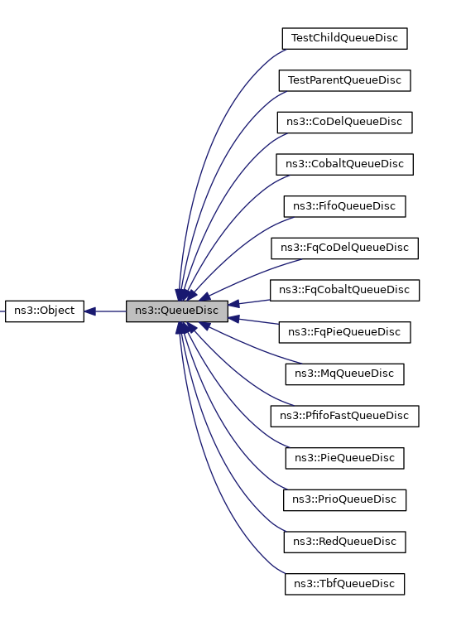
Inheritance diagram of queuedisc

Slide 8
Some public member functions:
1. void AddInternalQueue(Ptr<InternalQueue> queue)
2. void AddPacketFilter(Ptr<PacketFilter> filter)
3. int32_t Classify(Ptr<QueueDiscItem> Item)
4. Ptr<QueueDiscItem> Dequeue(void)
5. bool Enqueue(Ptr<QueueDiscItem> item)
6. QueueSize GetCurrentSize(void)
7. QueueSize GetMaxSize(void)
8. Ptr<PacketFilter> GetPacketFiler(std:: size_t i)
9.const Stats & GetStats(void)
10. bool SetMaxSize(QueueSize size)

Slide 9
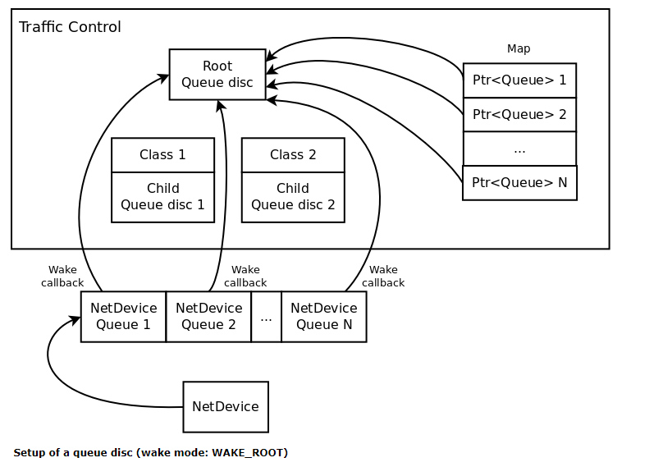
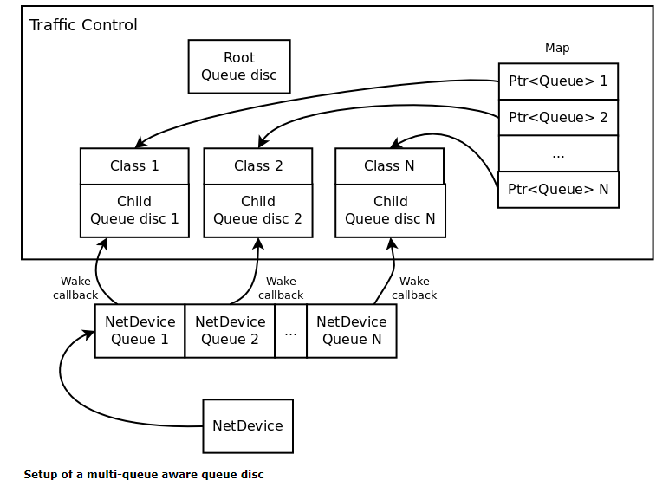
Set up of queue disc

Slide 10
QueueDiscFactory
This class stores object factories required to create a queue disc and all of its components such as Packet filters, internal queues, classes.

Slide 11
Some public member functions:
1. void AddInternalQueue(ObjectFactory factory)
2. void AddPacketFilter(ObjectFactory factory)
3. void AddQueueDiscClass(ObjectFactory factory)
4. Ptr<QueueDisc> CreateQueueDisc(const std::vector)
5. bool Enqueue(<Ptr<QueueDisc>> &queueDiscs)
6. void SetChildQueueDisc(uint16_t classId, uint16_t handle)

Slide 12
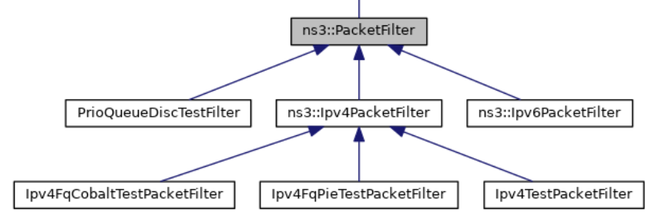
Packet-Filter Class
Base class used by Queue Discs to classify (hash) packets.
1.CheckProtocol (Ptr<QueueDiscItem> item)
- virtual, no implementation
2. DoClassify (Ptr<QueueDiscItem> item)
- virtual, no implementation

Slide 13
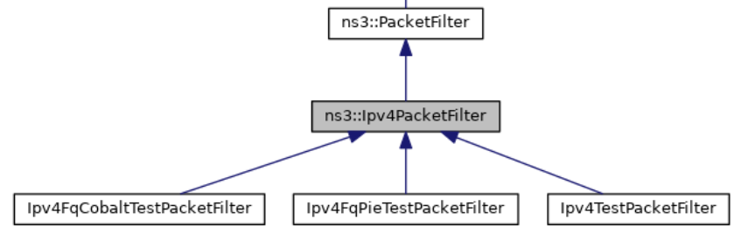
IPv4-Packet-Filter Class
Base class used by Queue Discs to classify (hash) IPV4 packets.
1.DoClassify (Ptr<QueueDiscItem> item)
- virtual, no implementation
2. CheckProtocol (Ptr<QueueDiscItem> item)
- Check given packet is an IPv4 packet with dynamic cast.

Slide 14
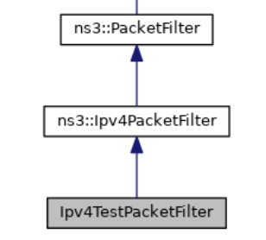
Ipv4-Test-Packet-Filter class
Simple test packet filter able to classify IPv4 packets.
1.DoClassify (Ptr<QueueDiscItem> item)
- Dummy hash implementation is given.
- We can add similar class when we require hashing packets.
- We will implement our hashing in DoClassify() of that class.

Slide 15


